Slide 1
The Neuromusculoskeletal System
and your Health and Well-Being

Slide 2
Definition
Neuro: pertaining to nerves and the nervous system of the body
Musculo: pertaining the muscle systems, the “movers and shakers” of the body
Skeletal: pertaining to the bone structure of the body-your skeleton

Slide 3
Neuromusculoskeletal System
The neuromusculoskeletal system is the interaction between the nervous system, muscle groups and joints and bones that move as a result of this interaction.
The nervous system “headquarters” is housed at the base of your brain. Branches of nerves spread throughout the body in order to send electric signals from the brain to muscles.
Once the signal is sent, that muscle fires off and moves, either contracting or stretching.

Slide 4
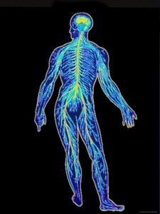

Slide 5
Musicians as Athletes
We don’t think of ourselves as “athletes” but in reality, we are using are bodies in the same way.
At a recent conference of the American College of Sports Medicine, they took up the topic of the physical demands on recreational and professional performing artists. They pointed out that:
We play or sing for long hours, even when it hurts.
Our heart rates exceed 65 percent of the maximum rate.
Injuries are just as common with musicians as with athletes.

Slide 6
Musicians as Athletes
We can avoid injury by taking some of the same precautions that athletes do:
Always warming up the body before any prolonged practice or performance
Relaxation exercises to release tension
Stretching specific muscle groups used in playing your instrument.

Slide 7


Slide 8
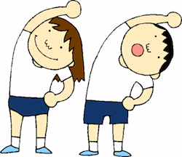

Slide 9
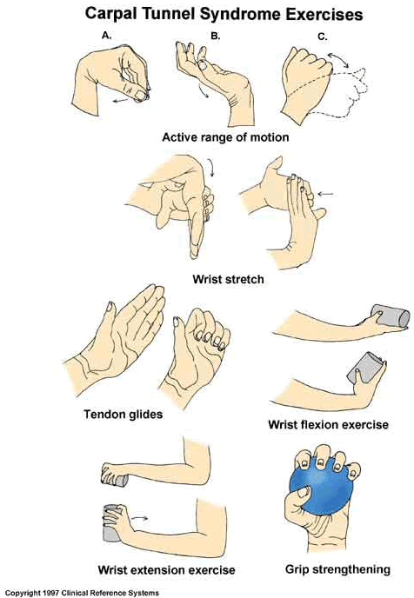

Slide 10
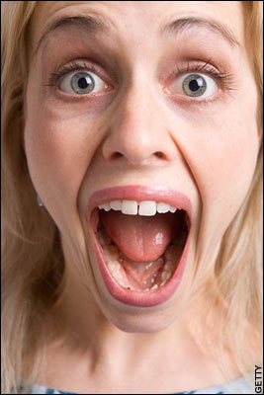

Slide 11
What Happens When You Overdo it!
Overuse: using muscle groups in a “normal” manner but exceeding their anatomical limit. Ask yourself
“ Am I changing my routine too quickly or too drastically?”
Misuse: using muscle groups in an “abnormal” way through excessive pressure, bad posture and poor technique.
Abuse: “playing through the pain”
If it hurts, STOP!!

Slide 12
How do neuromusculoskeletal issues affect the body?
Muscle Pain: caused by overuse, misuse, abuse, poor posture, tension, bad technique and poor conditioning. When a muscle breaks down, it becomes inflamed and causes pain.
Neuropathy: malfunction of specific nerves. Focal neuropathy is quite common among musicians. Symptoms include pain, numbness, tingling, burning, itching and weakness. Carpal Tunnel Syndrome is a form of focal neuropathy.
Dystonia: sustained, involuntary muscle contractions. Focal dystonia is common among keyboard, string, percussion and woodwind players.

Slide 13
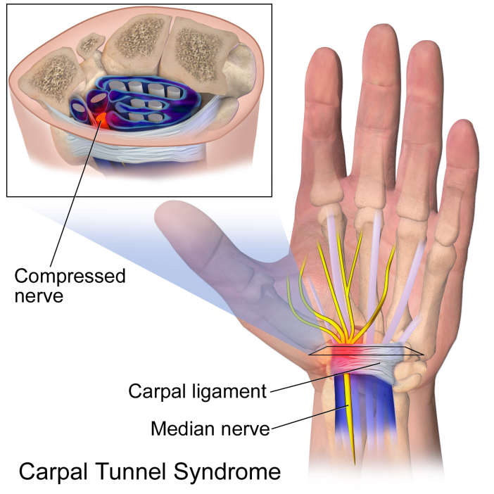

Slide 14
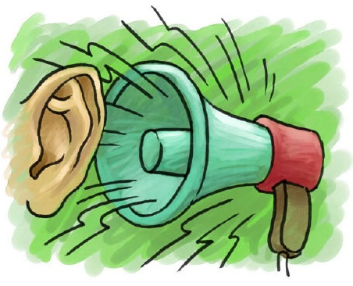
Facts about hearing loss

Slide 15
Facts about hearing loss
“Noise induced hearing loss” is caused by overexposure to extremely loud noises for a long period of time.
The tiny hair cells in your Inner Ear that transmit sound waves to the brain can get sheared off due to loud noises.
These hair cells never grow back, leaving you with permanent damage.
Hearing loss is more prevalent in younger people.

Slide 16
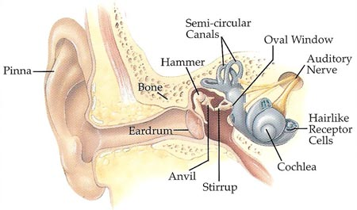

Slide 17
How to avoid hearing loss
Do not expose yourself to “noise” above 85 decibels.
Download a sound meter app on your phone.
Avoid using Ear Buds!
When listening to music through MP3,
follow the 60/60 rule:
Keep the volume level at 60% or less
Do not listen for more than 60 minutes
If you play in a band, wear ear plugs whenever possible.

Slide 18
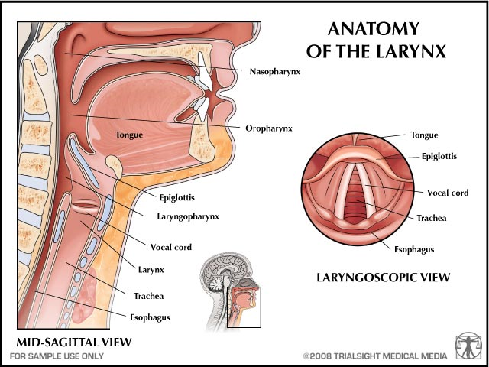

Slide 19
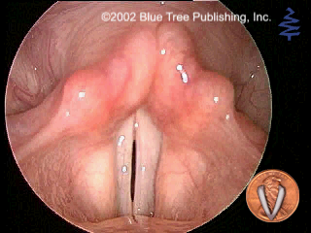
The Normal Larynx

Slide 20
What is Vocal Hygiene?
Webster’s New College Dictionary defines “hygiene” as: “ conditions and practices promoting or preserving health.”
Vocal hygiene therefore is:
TAKING CARE OF YOUR VOICE!!!
Taking good care of the singing voice starts with taking good care of your speaking voice.
Start by avoiding bad speaking habits.

Slide 21
Vocal Hygiene
AVOID:
SPEAKING WITH LOW OR NO BREATH FLOW
SPEAKING TOO LOW IN YOUR PITCH RANGE
TENSION IN THE LARYNX OR ARTICULATORS
Shouting and screaming!!
DO:
Healthy speaking begins about 1/3 up the speaking range.
Take adequate and frequent breaths
Avoid any unnecessary tensions

Slide 22
Healthy Speech and Singing
Don’t compete with loud noises, traffic, loud parties, games etc.
Eliminate shouting, screaming, and extended loud talking or non-stop talking.
Avoid excessive throat clearing or coughing.
DO NOT SPEAK IF IT HURTS!!
A singer should always warm up the voice first thing in the morning. This makes speaking throughout the day much more comfortable.

Slide 23
Hydration and The Mucous Blanket
The Mucous Blanket is the moist covering of the entire vocal tract including the larynx. It’s function is to protect against germs and inhaled particles. On the vocal folds, it reduces friction which is critical for the professional voice user. A dry larynx secretes thick, sticky mucous, which leads to stiff, irritated vocal folds. This can lead to vocal injury.
Improve hydration by DRINKING WATER
- ½ body weight in number of ounces per day
- 8-10 glasses per day (drink enough to “pee pale”)

Slide 24

Hydration and The Mucous Blanket

Slide 25
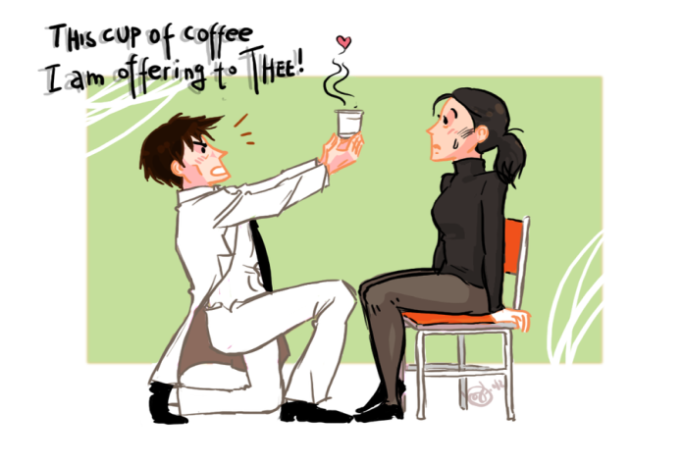
Avoid excess caffeine, alcohol, and certain medications

Slide 26
Change patterns of use/misuse
BAD SPEAKING/SINGING HABITS.
- glottal attacks
- throat clearing/coughs
- no warm ups before use
OVERUSE OF VOICE (usually vocationally).
POOR RESPIRATORY USE.
YELLING/SCREAMING / NO VOCAL REST.

Slide 27
The Common Cold
Rest your body and your voice.
Drink extra water to keep the mucous thin.
If it hurts to speak, do not try to sing!
If it doesn’t hurt, try light warm up only.
Do not sing for more than a few minutes at a time.
YOU CAN INJURE YOUR VOICE IF YOU SING WHEN YOU ARE SICK!!
Do the Mental Work of singing when ever possible.

Slide 28
Acute Laryngitis
Acute laryngitis is the most common vocal ailment caused by the common cold.
Laryngitis is defined as “swelling of the tissue of the larynx” – more specifically the vocal folds. The entire larynx will also appear red.
Acute laryngitis is caused by a viral infection (such as a cold).
Symptoms include loss of phonation, pitch breaks and loss of range.
Complete vocal rest, antibiotics and hydration are recommended.

Slide 29
GERD!!!!
Gastro-esophageal-reflux-disease is a VERY common condition affecting LOTS of people. It is caused when one or both of the sphincters or valves at either end of the esophagus do not close completely, allowing stomach contents and acid to “reflux” back into the pharynx and larynx. It will cause redness, swelling and mucous production. It can cause damage to the vocal folds. The main symptom of GERD is heartburn.

Slide 30
GERD!!!!
If you are clearing your throat a lot after eating, it is likely you have GERD.
Avoid caffeine, spicy or fried food and in some cases any foods with gluten.
Avoid carbonated beverages.
Raise the head of the bed when sleeping.
GERD is treatable with such medications as Prilosec or Nexium.
Severe cases may require surgery.

Slide 31
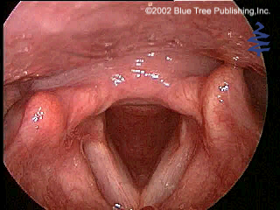
GERD

Slide 32
How to stay healthy!
As a performing artist and a future professional performer, you can take actions TODAY that will keep you healthy, active and productive:
Modify your diet.
Exercise regularly.
Get plenty of sleep.

Slide 33

Eat plenty of fresh fruits and vegetables

Slide 34

Limit fried or fatty foods

Slide 35
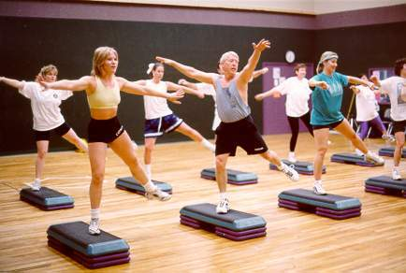
Aerobic Exercise

Slide 36
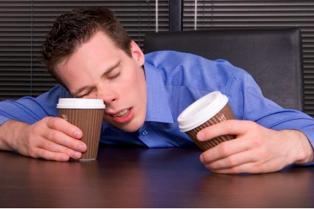
Try to get 7-8 hours of sleep

Slide 37
References
National Association of Schools of Music
Performing Arts Medicine Association
“Protect Your Neuromusculoskeletal and Vocal Health Every Day” – 2013
National Association of Schools of Music
Performing Arts Medicine Association
“Protect Your Hearing Every Day”- 2011
Vocal Education Module , Blue Tree Publishing Inc. 2002
Google Images: https://www.google.com/imghp?hl=en&tab=wi&ei=XW36U-SBI8ndqwaD8oGgCQ&ved=0CAQQqi4oAg

